Slide 1


Amajit Mitra
13th September 25

Slide 2

Outline
Executive Summary
Introduction
Methodology
Results
Conclusion
Appendix

Slide 3
Executive Summary
Objective:
Analyze SpaceX launch performance and drivers of successful landings.
Data:
SpaceX REST API + Wikipedia web scraping + curated CSVs.
Methods:
EDA (viz + SQL), interactive analytics (Folium/Plotly Dash), classification modeling.
Key Findings:
Success increases with specific booster versions & payload ranges; coastal sites benefit recovery ops.
Impact:
Provides evidence-backed insights to optimize launch planning and site logistics.

Slide 4
Introduction
Business context:
Improving launch success rates reduces cost per launch.
Questions:
Which factors correlate with success? How do sites differ?
Scope:
Falcon 9/Heavy launches; outcomes, payloads, sites, orbits, dates.
Assumptions:
Public data fidelity; approximate geospatial proximity via web map.

Slide 5

Section 1

Slide 6
Methodology
Executive Summary
Data collection methodology:
SpaceX REST API + Wikipedia scraping.
Perform data wrangling
Cleaning, typing, dedupe, harmonized features.
Perform exploratory data analysis (EDA) using visualization and SQL
Perform interactive visual analytics using Folium and Plotly Dash
Perform predictive analysis using classification models
Train/test split, baseline, classification models, evaluation.

Slide 7
Data Collection
Data collections are done through the following two methods:
SpaceX API
Scraping

Slide 8
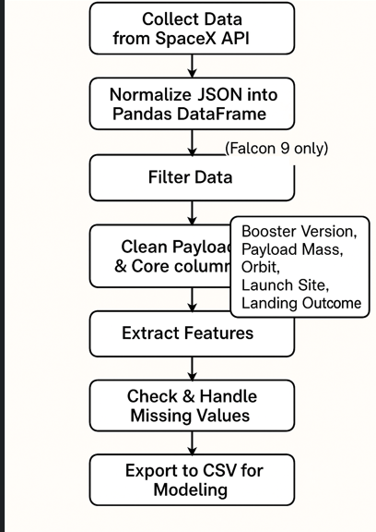
Data Collection – SpaceX API
REST endpoints for launches, rockets, payloads; joined on IDs.
Rate-limited requests; cached responses to JSON/CSV.
Validation: schema checks & counts across entities.
GitHub URL of the completed SpaceX API calls notebook:
https://github.com/AmajitMitra/IBM-DS-Capstone-Project/blob/main/Data%20Collection%20API%20Lab.ipynb

Slide 9
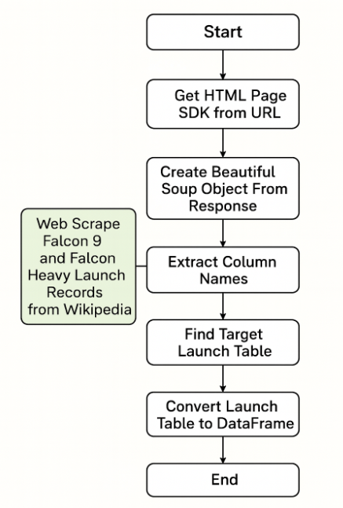
Data Collection - Scraping
Wikipedia tables parsed via BeautifulSoup.
Extracted launch tables, normalized column names, types.
Reconciled with API data (date/site/version).
GitHub URL of the completed web scraping notebook
https://github.com/AmajitMitra/IBM-DS-Capstone-Project/blob/main/Data%20Collection%20webscrapping.ipynb

Slide 10
Data Wrangling
Type coercion for dates, numeric payloads; timezone normalization.
Feature engineering: success flag, orbit categories, payload bins.
Deduplication: site aliases, booster version standardization.
GitHub URL to wrangling notebooks:
https://github.com/AmajitMitra/IBM-DS-Capstone-Project/blob/main/Data%20wrangling.ipynb

Slide 11
EDA with Data Visualization
Univariate: distributions of payload, outcomes, orbits.
Bivariate: payload vs. success, flight number vs. site/orbit.
Temporal: yearly success trend by site/version.
Design: labeled axes, units, clear legends, and context.
GitHub URL of your completed EDA with data visualization notebook
https://github.com/AmajitMitra/IBM-DS-Capstone-Project/blob/main/EDA%20with%20Visualisation.ipynb

Slide 12
EDA with SQL
Questions: sites, payload aggregates, firsts, rankings.
Queries: DISTINCT, GROUP BY/AGG, HAVING, windowed filters.
Validation: row counts vs. visualization outputs.
GitHub URL of your completed EDA with SQL notebook
https://github.com/AmajitMitra/IBM-DS-Capstone-Project/blob/main/EDA%20with%20SQL.ipynb

Slide 13
Build an Interactive Map with Folium
Layers: site markers, outcome clusters, proximity lines.
Proximities: nearest coastline, railway, highway, city via Haversine.
Outputs: distance table and annotated map screenshots.
GitHub URL of your completed interactive map with Folium map
https://github.com/AmajitMitra/IBM-DS-Capstone-Project/blob/main/FoliumLab.ipynb

Slide 14
Build a Dashboard with Plotly Dash
Summarize what plots/graphs and interactions you have added to a dashboard
Explain why you added those plots and interactions
Add the GitHub URL of your completed Plotly Dash lab, as an external reference and peer-review purpose

Slide 15
Predictive Analysis (Classification)
Summarize how you built, evaluated, improved, and found the best performing classification model
You need present your model development process using key phrases and flowchart
GitHub URL of your completed predictive analysis lab, as an external reference and peer-review purpose
https://github.com/AmajitMitra/IBM-DS-Capstone-Project/blob/main/Hands%20on%20Lab%20Complete%20the%20Machine%20Learning%20Prediction%20lab.ipynb

Slide 16
Results
Exploratory data analysis results
Interactive analytics demo in screenshots
Predictive analysis results

Slide 17

Section 2

Slide 18
Flight Number vs. Launch Site
Show a scatter plot of Flight Number vs. Launch Site
Show the screenshot of the scatter plot with explanations

Slide 19
Payload vs. Launch Site
Show a scatter plot of Payload vs. Launch Site
Show the screenshot of the scatter plot with explanations

Slide 20
Success Rate vs. Orbit Type
Show a bar chart for the success rate of each orbit type
Show the screenshot of the scatter plot with explanations

Slide 21
Flight Number vs. Orbit Type
Show a scatter point of Flight number vs. Orbit type
Show the screenshot of the scatter plot with explanations

Slide 22
Payload vs. Orbit Type
Show a scatter point of payload vs. orbit type
Show the screenshot of the scatter plot with explanations

Slide 23
Launch Success Yearly Trend
Show a line chart of yearly average success rate
Show the screenshot of the scatter plot with explanations

Slide 24
All Launch Site Names
Find the names of the unique launch sites
Present your query result with a short explanation here

Slide 25
Launch Site Names Begin with 'CCA'
Find 5 records where launch sites begin with `CCA`
Present your query result with a short explanation here

Slide 26
Total Payload Mass
Calculate the total payload carried by boosters from NASA
Present your query result with a short explanation here

Slide 27
Average Payload Mass by F9 v1.1
Calculate the average payload mass carried by booster version F9 v1.1
Present your query result with a short explanation here

Slide 28
First Successful Ground Landing Date
Find the dates of the first successful landing outcome on ground pad
Present your query result with a short explanation here

Slide 29
Successful Drone Ship Landing with Payload between 4000 and 6000
List the names of boosters which have successfully landed on drone ship and had payload mass greater than 4000 but less than 6000
Present your query result with a short explanation here

Slide 30
Total Number of Successful and Failure Mission Outcomes
Calculate the total number of successful and failure mission outcomes
Present your query result with a short explanation here

Slide 31
Boosters Carried Maximum Payload
List the names of the booster which have carried the maximum payload mass
Present your query result with a short explanation here

Slide 32
2015 Launch Records
List the failed landing_outcomes in drone ship, their booster versions, and launch site names for in year 2015
Present your query result with a short explanation here

Slide 33
Rank Landing Outcomes Between 2010-06-04 and 2017-03-20
Rank the count of landing outcomes (such as Failure (drone ship) or Success (ground pad)) between the date 2010-06-04 and 2017-03-20, in descending order
Present your query result with a short explanation here

Slide 34

Section 3

Slide 35
<Folium Map Screenshot 1>
Replace <Folium map screenshot 1> title with an appropriate title
Explore the generated folium map and make a proper screenshot to include all launch sites’ location markers on a global map
Explain the important elements and findings on the screenshot

Slide 36
<Folium Map Screenshot 2>
Replace <Folium map screenshot 2> title with an appropriate title
Explore the folium map and make a proper screenshot to show the color-labeled launch outcomes on the map
Explain the important elements and findings on the screenshot

Slide 37
<Folium Map Screenshot 3>
Replace <Folium map screenshot 3> title with an appropriate title
Explore the generated folium map and show the screenshot of a selected launch site to its proximities such as railway, highway, coastline, with distance calculated and displayed
Explain the important elements and findings on the screenshot

Slide 38

Section 4

Slide 39
<Dashboard Screenshot 1>
Replace <Dashboard screenshot 1> title with an appropriate title
Show the screenshot of launch success count for all sites, in a piechart
Explain the important elements and findings on the screenshot

Slide 40
<Dashboard Screenshot 2>
Replace <Dashboard screenshot 2> title with an appropriate title
Show the screenshot of the piechart for the launch site with highest launch success ratio
Explain the important elements and findings on the screenshot

Slide 41
<Dashboard Screenshot 3>
Replace <Dashboard screenshot 3> title with an appropriate title
Show screenshots of Payload vs. Launch Outcome scatter plot for all sites, with different payload selected in the range slider
Explain the important elements and findings on the screenshot, such as which payload range or booster version have the largest success rate, etc.

Slide 42

Section 5

Slide 43
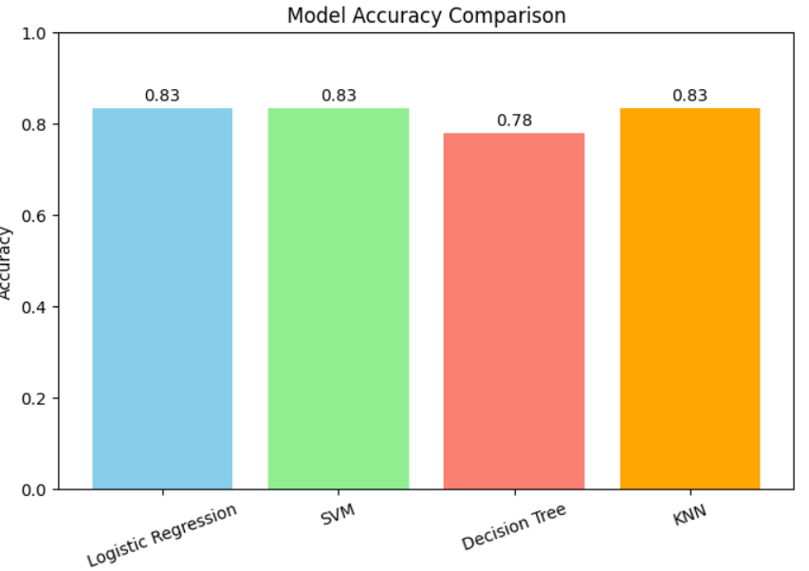
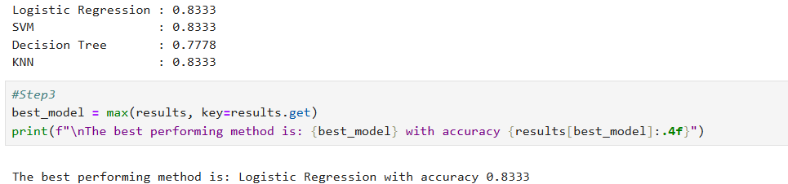
Classification Accuracy
Visualize the built model accuracy for all built classification models, in a bar chart
Logistic Regression is the model that has the highest classification accuracy.

Slide 44
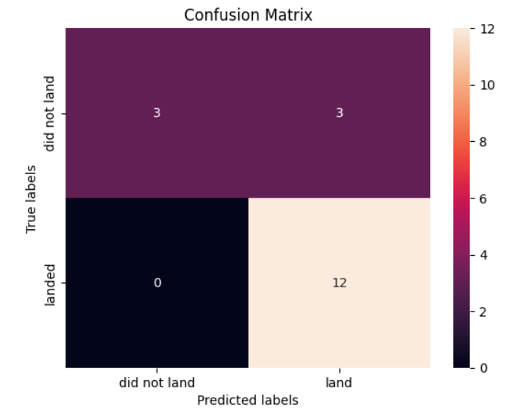
Confusion Matrix
Logistic Regression is the best performing model for the provided dataset with best test accuracy of 0.833
confusion matrix of Logistic Regression is presented on the right side.

Slide 45
Conclusions
Point 1
Point 2
Point 3
Logistic Regression is the best fitted predictive analysis model for the given data set.
…

Slide 46
Appendix
Include any relevant assets like Python code snippets, SQL queries, charts, Notebook outputs, or data sets that you may have created during this project

Slide 47


